Slide 1
TECHNOLOGY FOR STATISTICAL ANALYSIS

Slide 2
One Variable Statistics
Using a Graphing Calculator
Using DESMOS

Slide 3
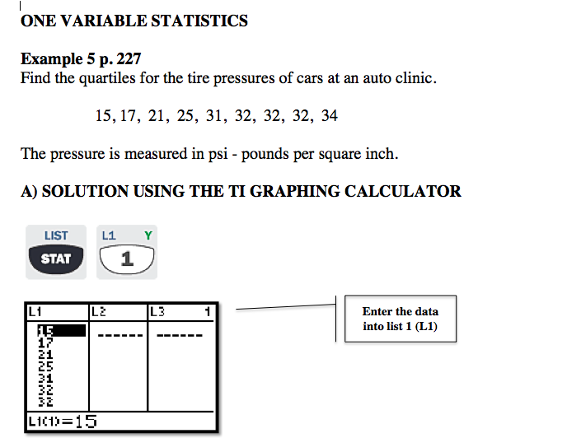
Example 1 p.217

Slide 4
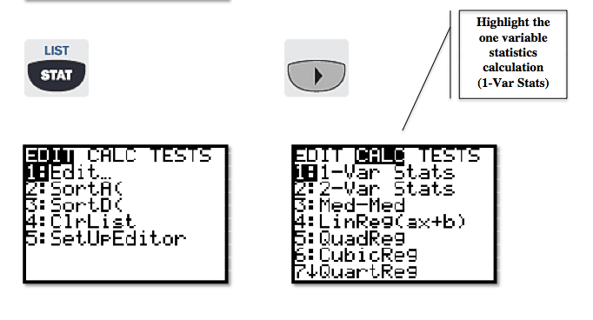

Slide 5
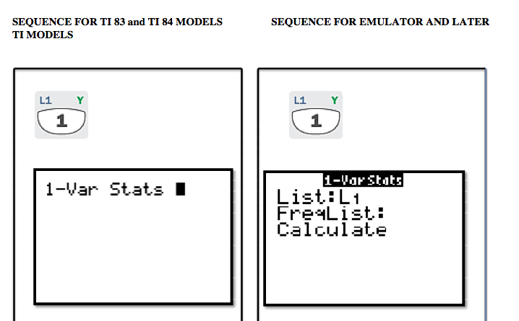

Slide 6
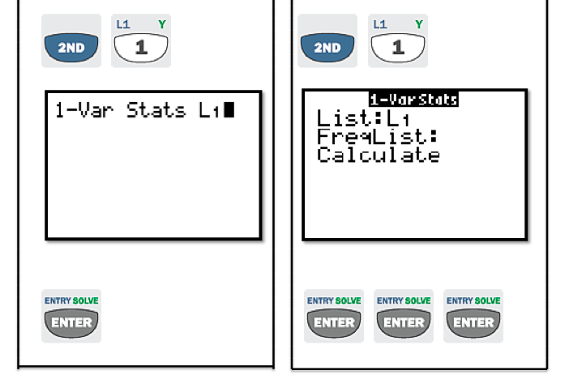

Slide 7
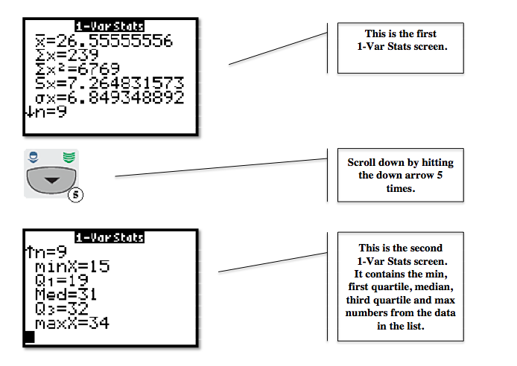

Slide 8
Example 1 p.217

Slide 9
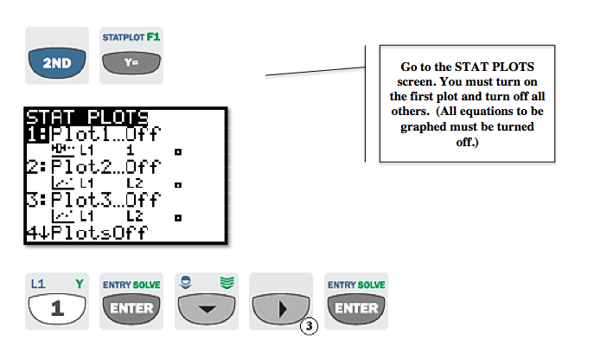

Slide 10
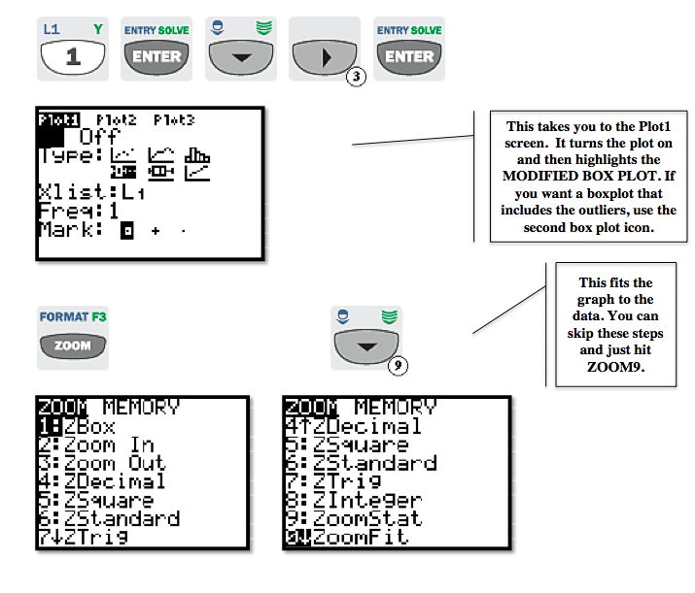

Slide 11
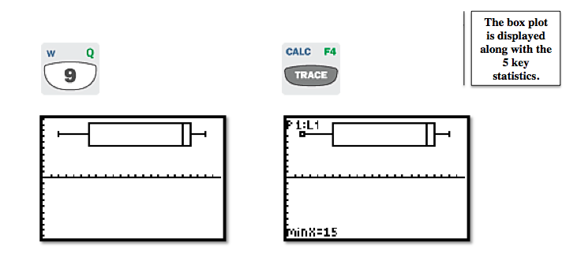

Slide 12
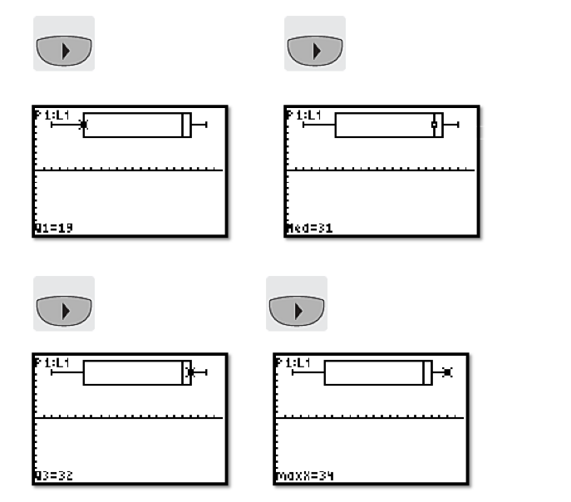

Slide 13
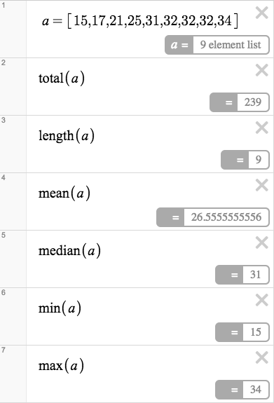
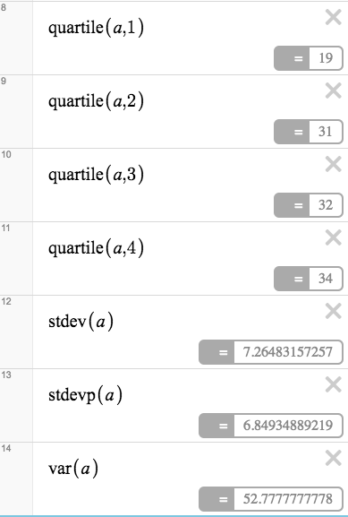
DESMOS:
ONE VARIABLE
STATISTICS

Slide 14
SCATTER PLOTS

Slide 15
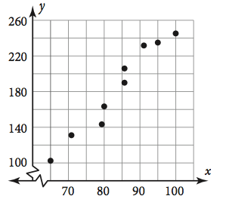
Any set of numbers is called a set of data.
A single set of numbers is called univariate data.
Bivariate data involves pairs of numbers that are analyzed simultaneously.
A scatterplot is a graph that shows bivariate data using points. It may illustrate a relationship or trend within the data.

Slide 16
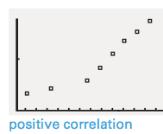
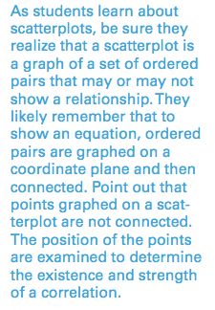
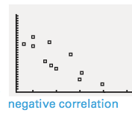
A trend may show a correlation, or association, between two variables.
A positive correlation exists if the value of one variable increases when the value of the other increases.
A negative correlation exists if the value of one variable decreases when the value of the other variable increases.

Slide 17
A trend may show a causal relationship, which means one variable caused a change in the other variable.
The variable which caused the change in the other variable is the explanatory variable. The affected variable is the response variable.
While a trend may indicate a correlation or a causal relationship,
IT DOES NOT HAVE TO. If two variables are correlated, it does not mean that one caused the other!

Slide 18
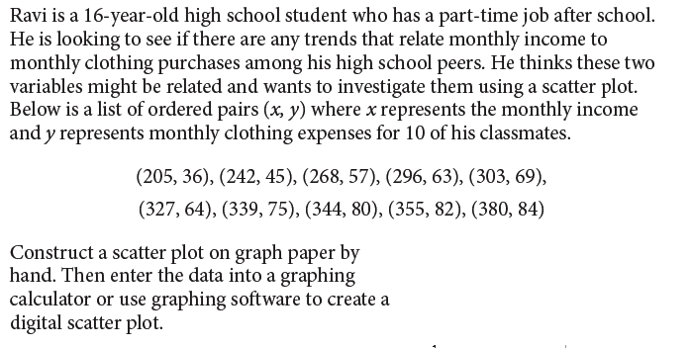
EXAMPLE 1 p. 45
Choose a scale for each axis that allows the scatterplot to fit in the required space. To choose the scale, look at the greatest and the least numbers that must be plotted for each variable. Label the axes accordingly. Then plot each point with a dot.

Slide 19
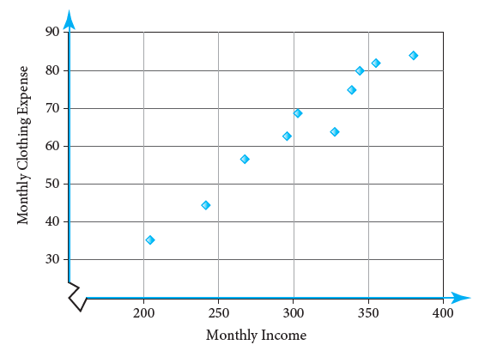

Slide 20
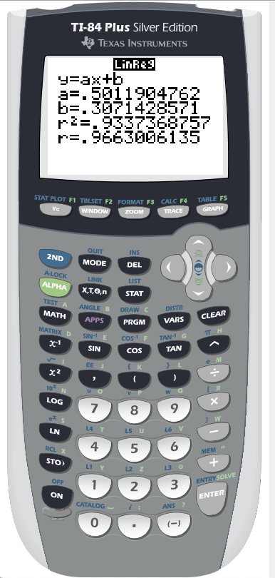
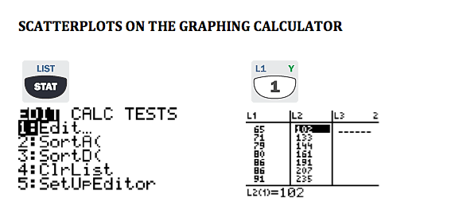

Slide 21
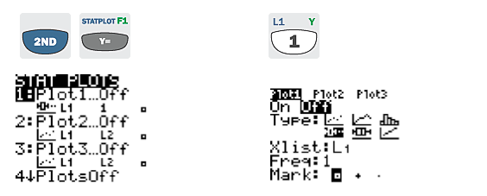

Slide 22
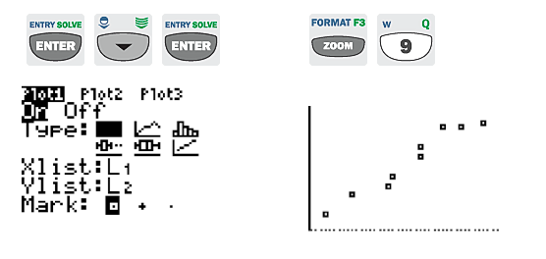

Slide 23
www.desmos.com/calculator

Slide 25
ENTER EACH DATA POINT
ONE AT A TIME

Slide 26
OR…. Start with a blank untitled graph.

Slide 27
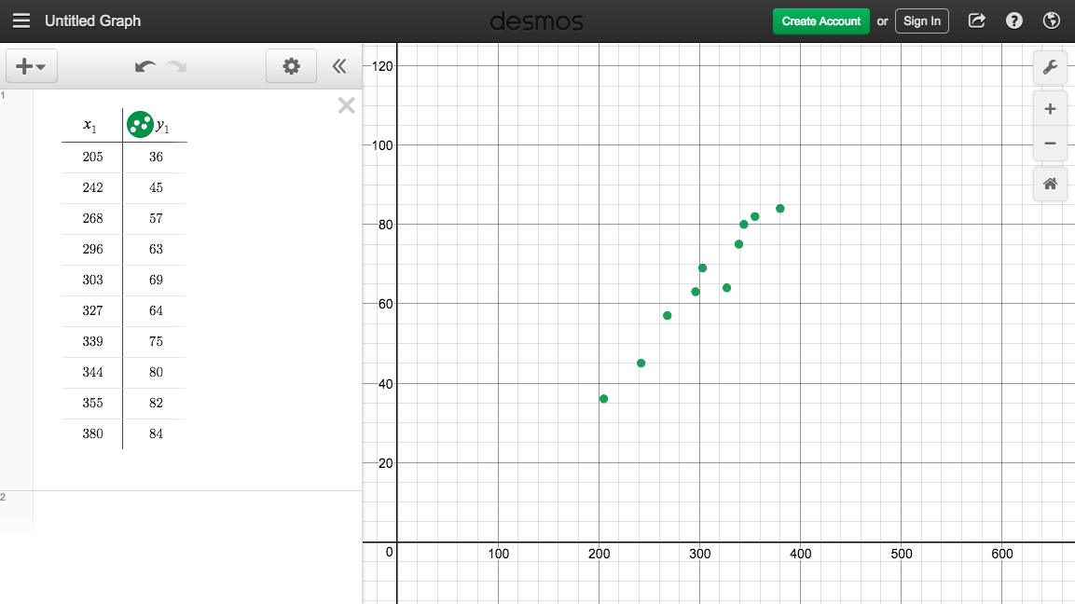
Click on box 1. Copy and paste EXCEL data into box

Slide 28
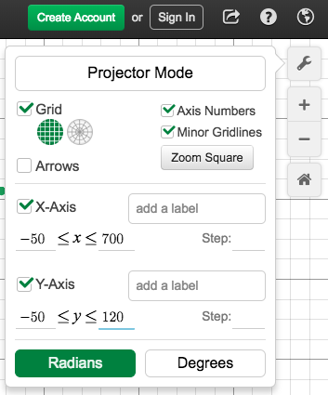
Tighten the viewing window using the wrench tool.

Slide 29
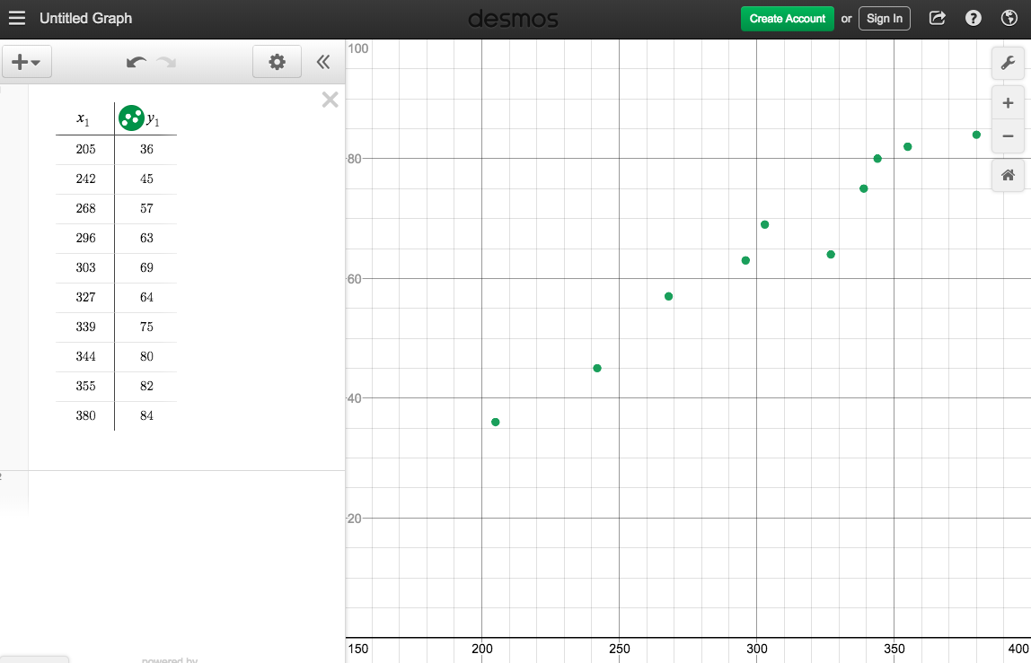
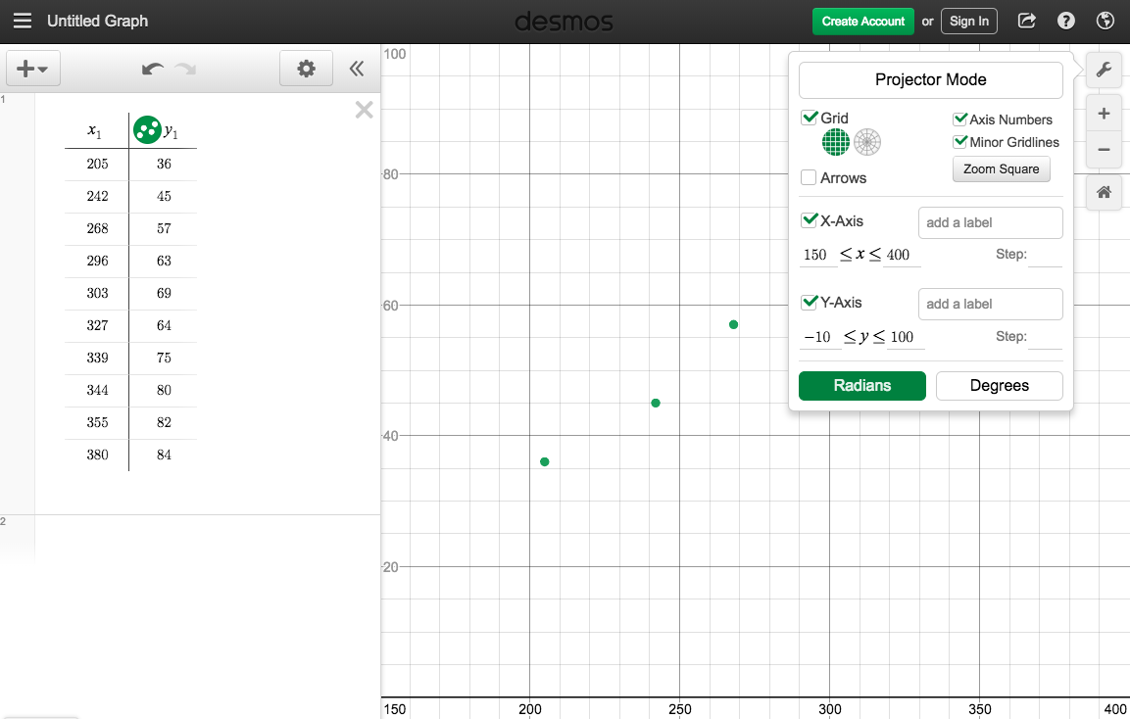

Slide 30
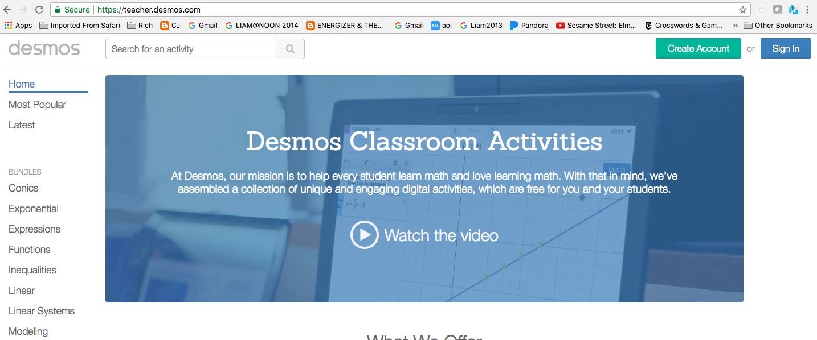
MAKING DESMOS STUDENT ACTIVITIES
teacher.desmos.com
Sign in with your teacher account

Slide 31
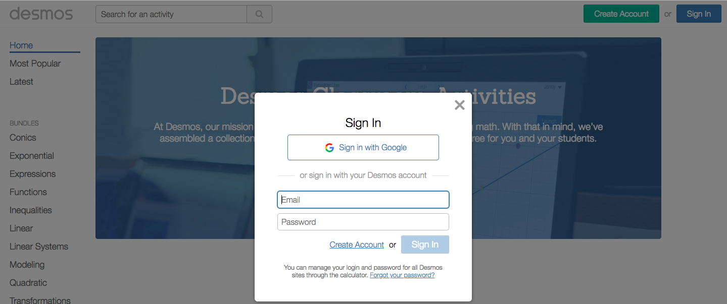

Slide 32
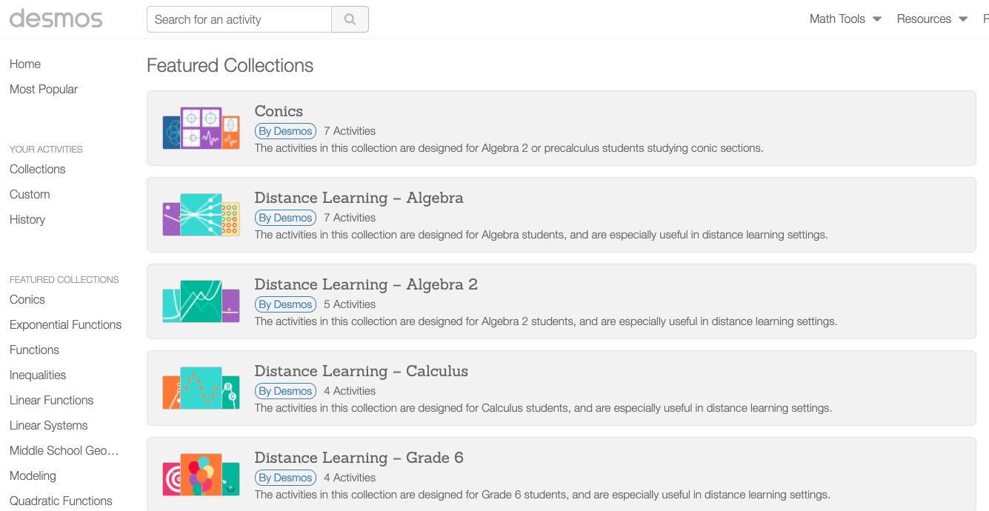
USE A PRE-MADE ACTIVITY OR CREATE YOUR OWN
CLICK ON CUSTOM

Slide 33
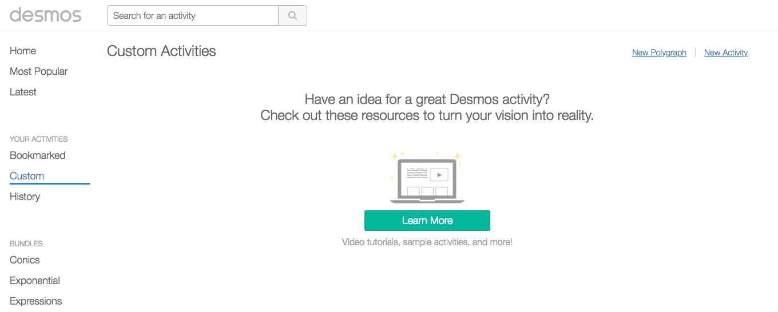
CREATE A NEW ACTIVITY

Slide 34
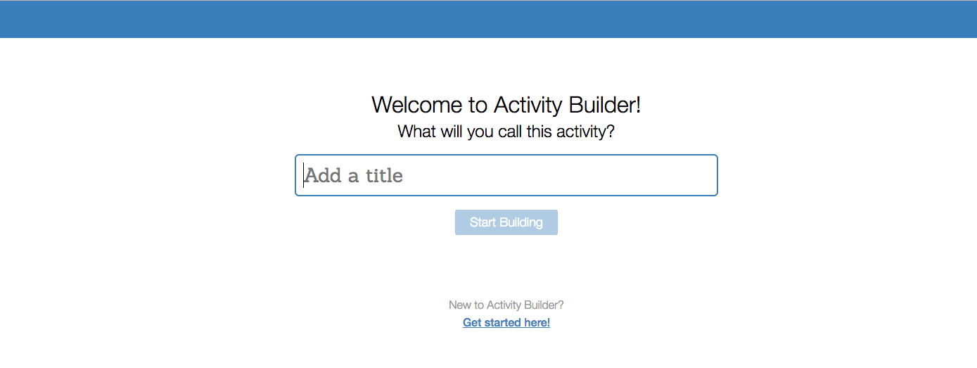
NAME YOUR ACTIVITY

Slide 35
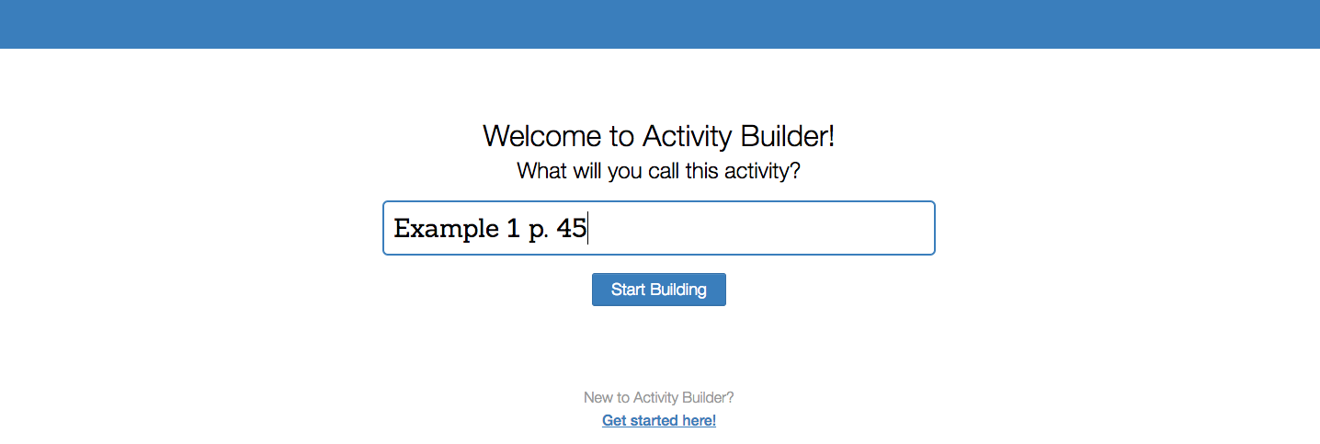
THIS ACTIVITY USES THE DATA FROM EXAMPLE 1 ON PAGE 45

Slide 36
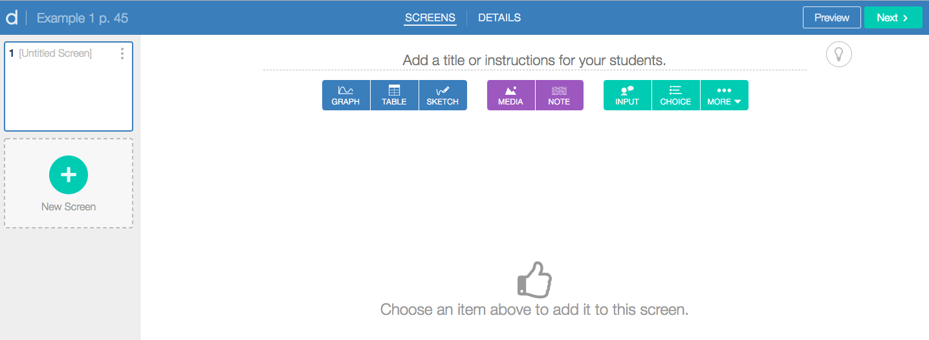
A BASIC ACTIVITY WILL USUSALLY CONSIST OF A GRAPH
CLICK ON THE GRAPH BOX

Slide 37
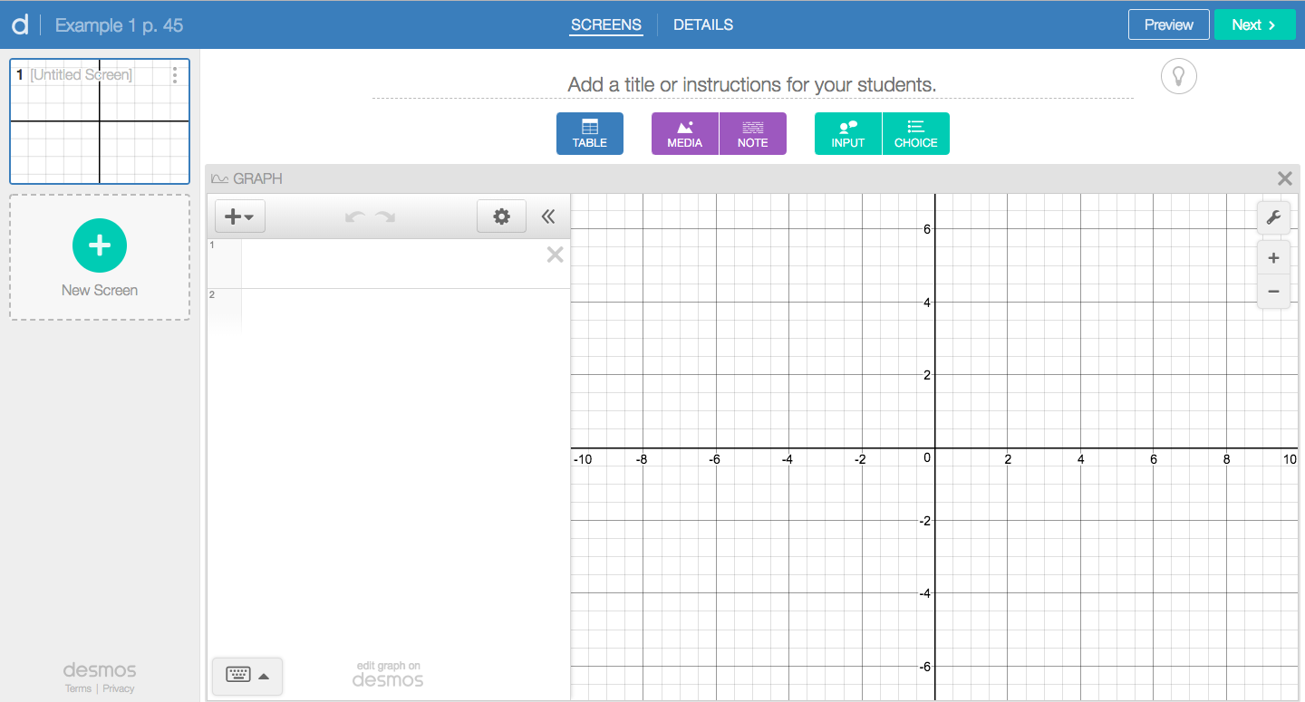
THE DESMOS CALCULATOR SCREEN

Slide 38
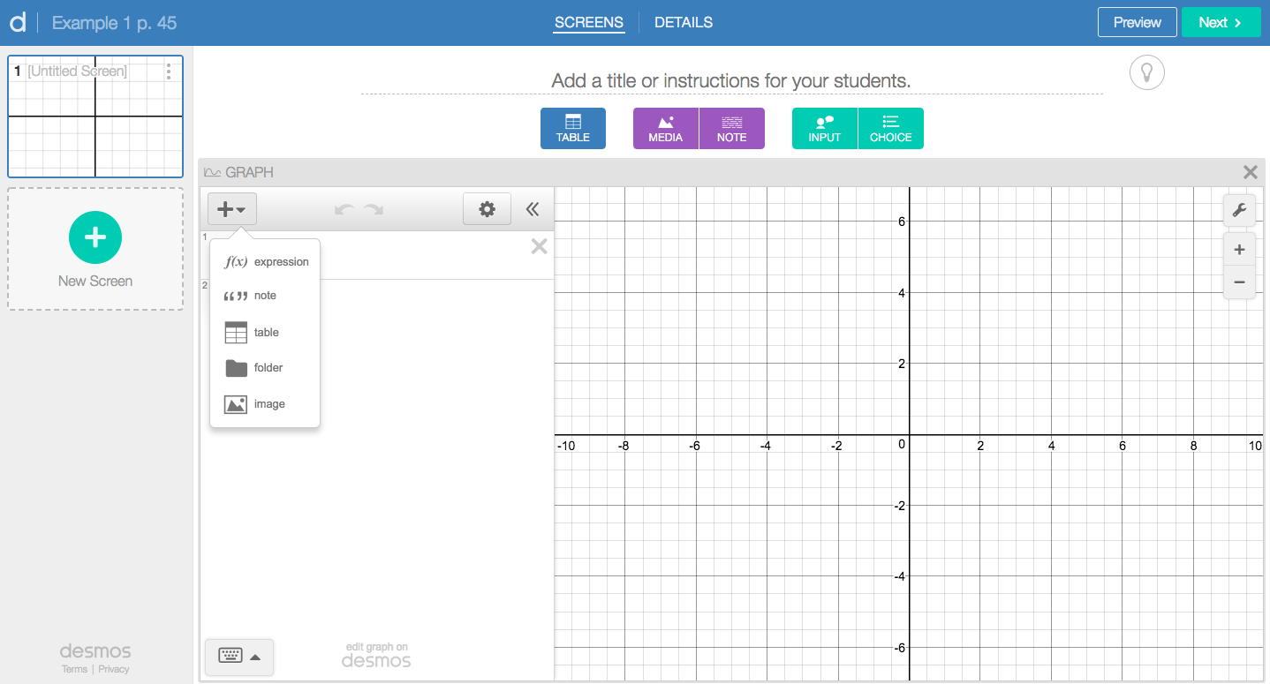
CLICK ON THE “+” TAB, THEN “TABLE”

Slide 39
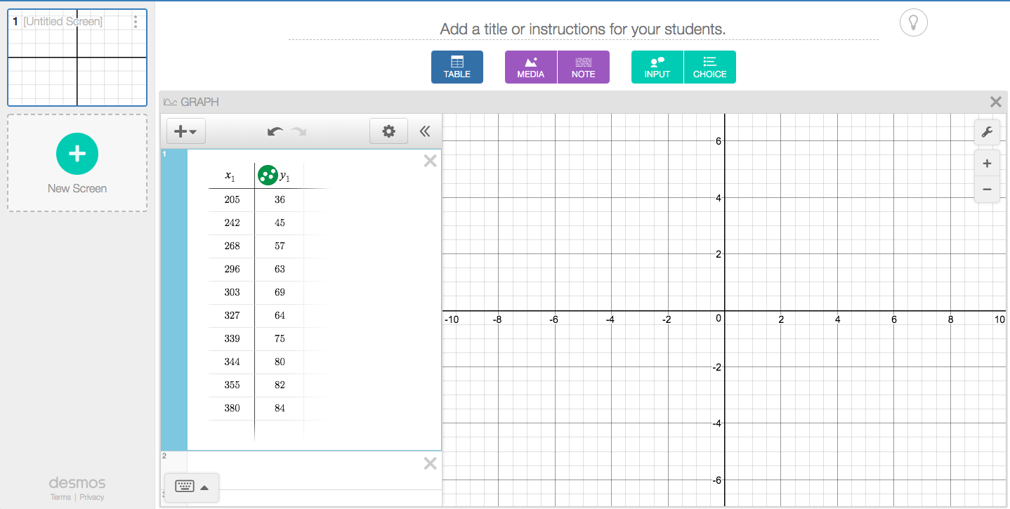
ENTER THE DATA INTO THE TABLE

Slide 40
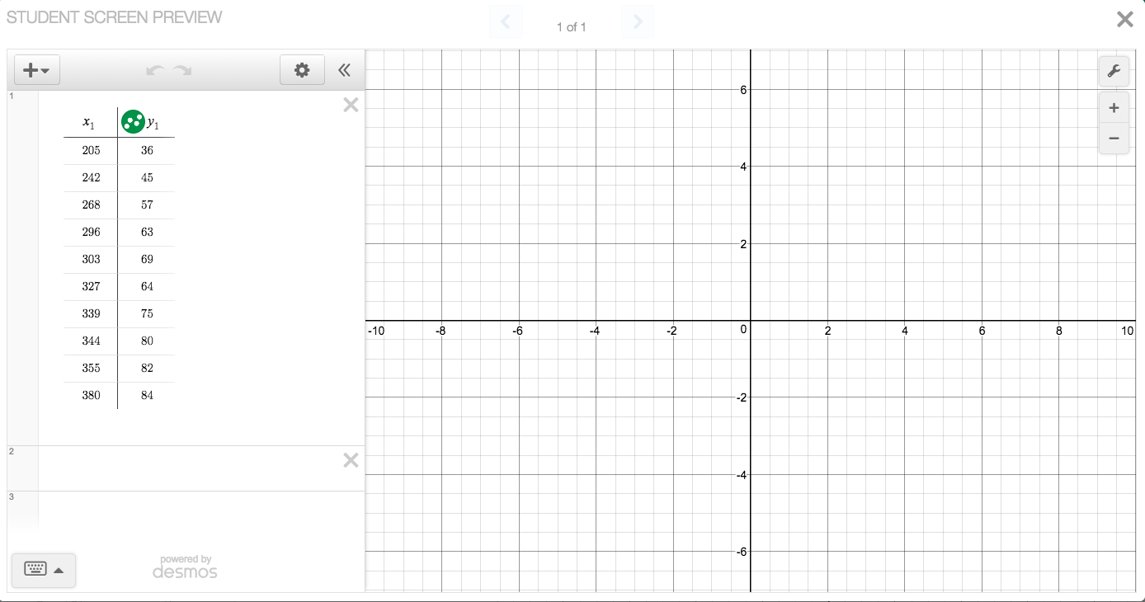
YOU CAN PREVIEW WHAT STUDENTS WILL SEE

Slide 41
YOU ARE DONE CREATING THE ACTIVITY

Slide 42
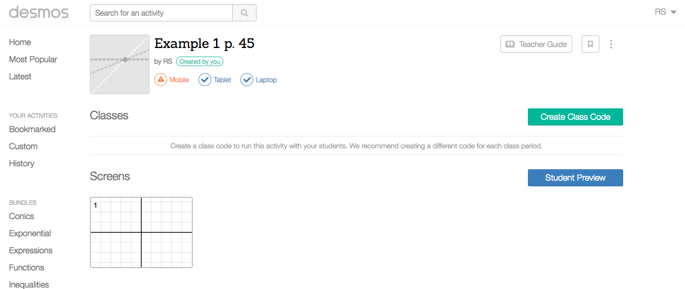
STUDENTS WILL ACCESS THE ACTIVITY BY A CODE NAME.
CLICK CREATE A CLASS CODE

Slide 43
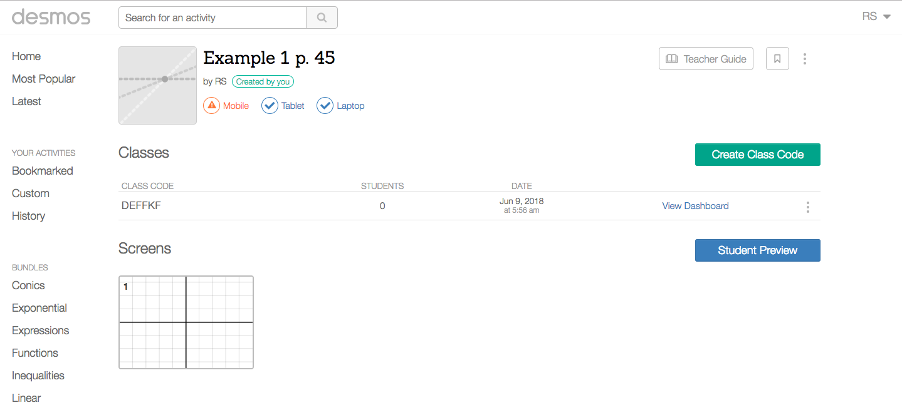
DESMOS ASSIGNS A CLASS CODE FOR YOUR ACTIVITY
GIVE THE ACTIVITY CODE TO STUDENTS

Slide 44
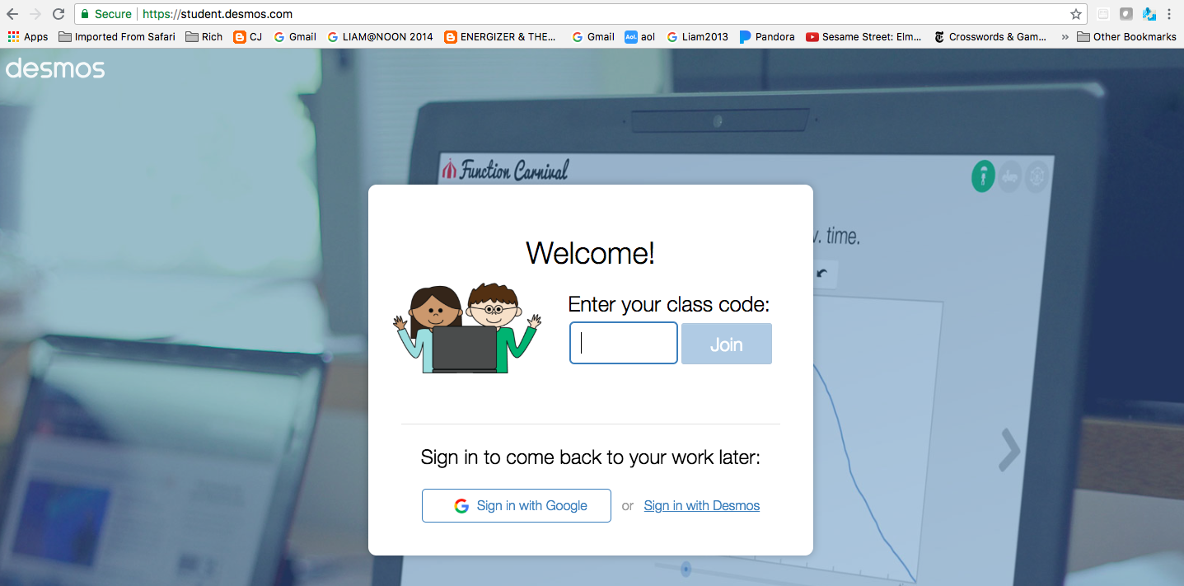
STUDENTS CAN ACCESS ACTIVITIES YOU HAVE CREATED BY USING THE CLASS CODE FOR THAT ACTIVITY. THEY ENTER THE CODE AT student.desmos.com

Slide 45
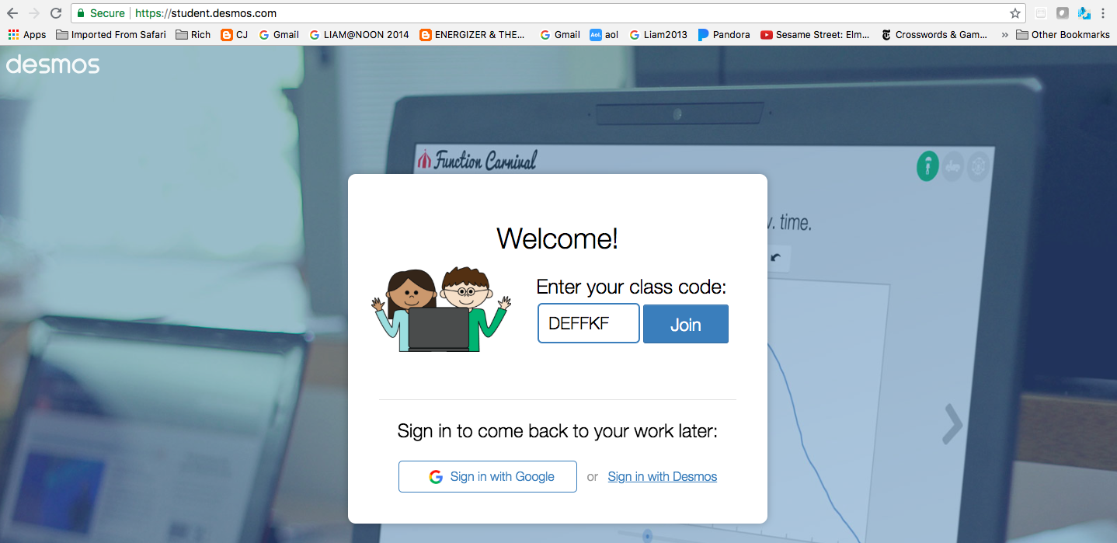
THIS IS THE CLASS CODE FOR THE EXAMPLE 1 P.45 ACTIVITY

Slide 46
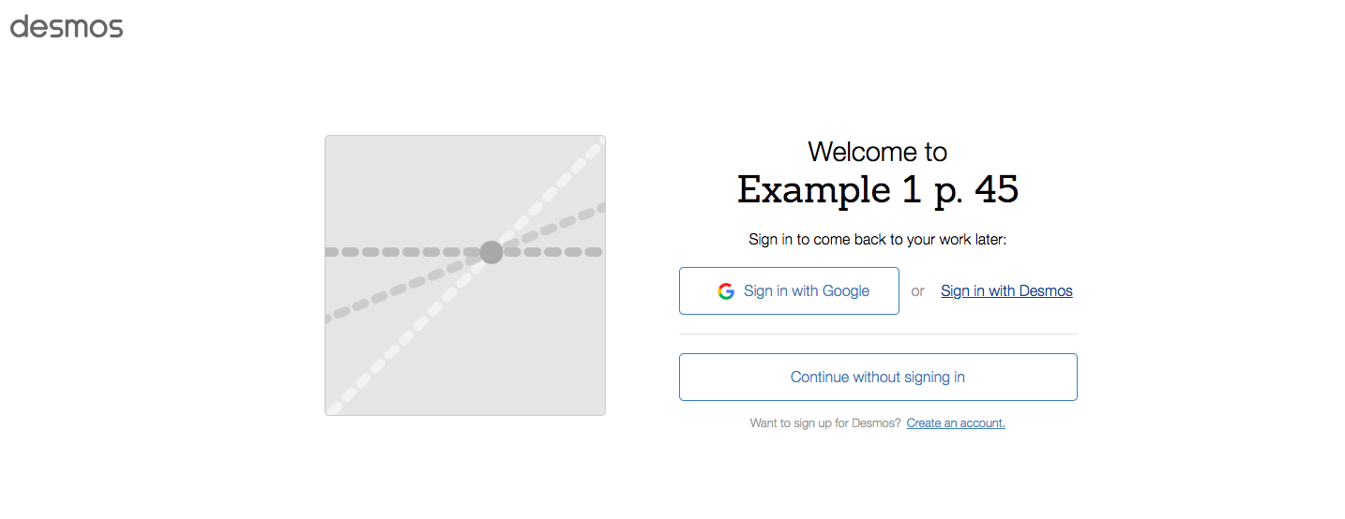
STUDENTS WILL NOW BE TAKEN TO THE SIGN-IN SCREEN.
THEY SHOULD SIGN IN WITH THEIR PERSONAL ACCOUNT INFORMATION.

Slide 47
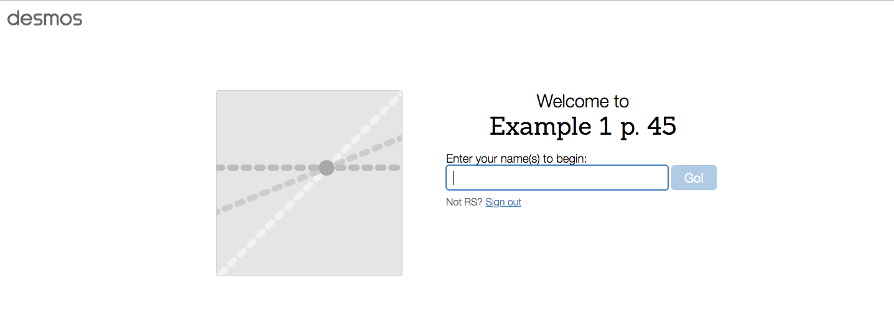
THEIR ACCOUNT NAME WILL APPEAR OR THEY CAN TYPE THAT NAME IN THE BOX, THEN CLICK “GO”.

Slide 48
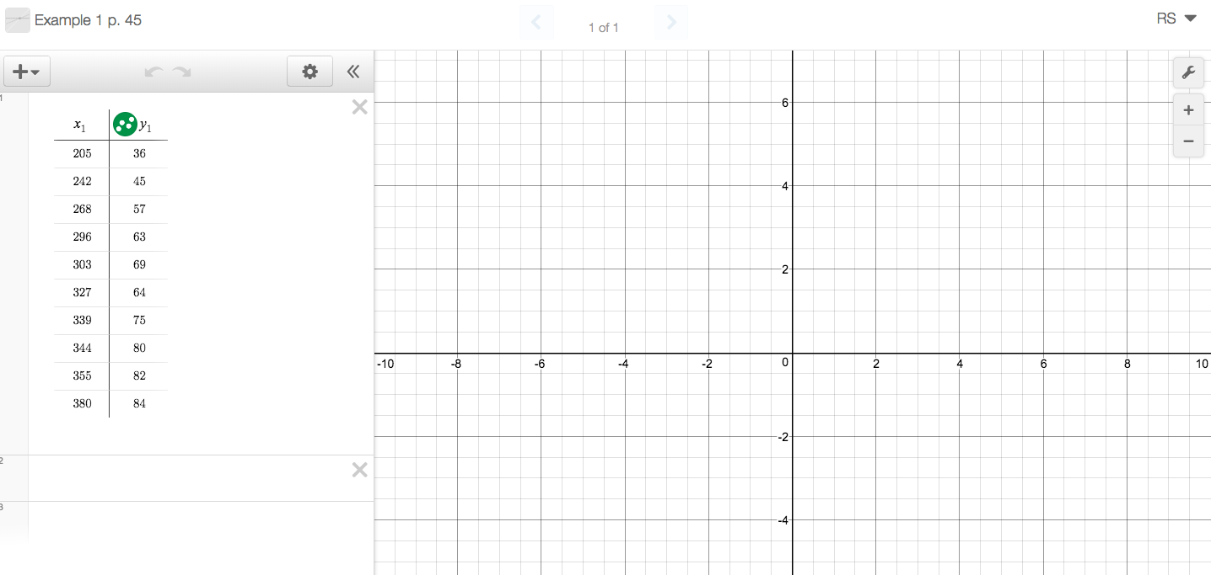
NOW THEY CAN BEGIN YOUR ACTIVITY BY ENTERING THE COMMANDS UNDER THE TABLE.

Slide 49
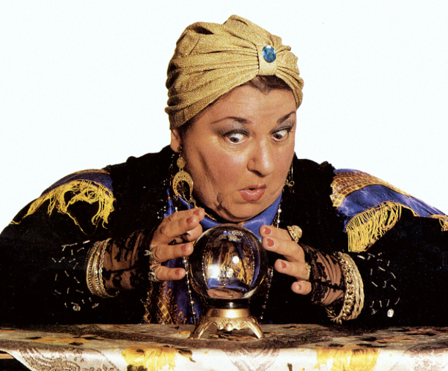
REGRESSION ANALYSIS
REGRESSION ANALYSIS
USING MATH
TO MAKE PREDICTIONS

Slide 51
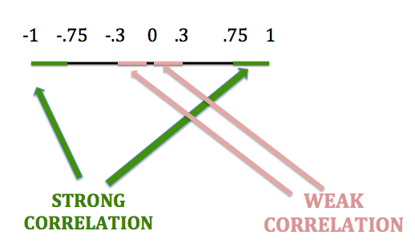
The correlation coefficient, r, is a number between -1 and 1 inclusive that is used to judge how closely the line fits the data. Negative correlation coefficients show negative correlations and positive correlation coefficients show positive correlation. If the correlation coefficient is near 0, there is little or no correlation.
Correlation coefficients with an absolute value greater than 0.75 are considered to be strong correlations.
Correlation coefficients with an absolute value less than 0.3 are considered weak correlations.
Any other correlation is a moderate correlation.

Slide 52
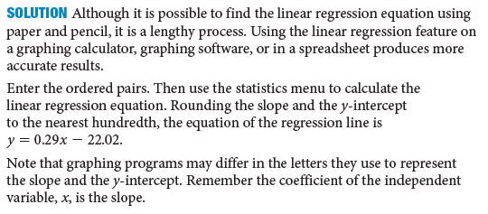
p. 49

Slide 53
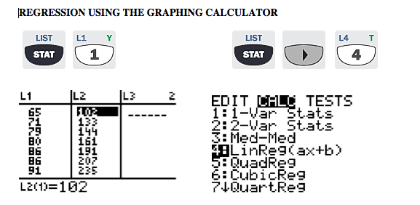

Slide 54
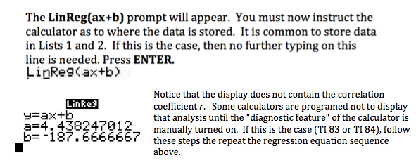

Slide 55
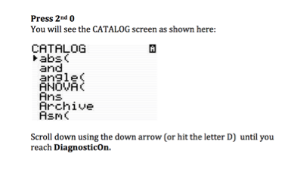
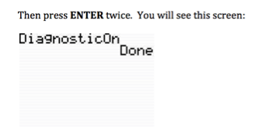
Now repeat the regression keystrokes and your display will show the full analysis including the correlation coefficient r.

Slide 57
REGRESSION ANALYSIS USING DESMOS
Enter the data in a table. Click on box 2. Type y1 ~ mx1 + b. Desmos will subscript it for you.
Once the general linear regression equation is completed,
the values for m, b, r², and r will be displayed.

Slide 58
. .
. .
. .

